Slide 1

Backup And Restore In
Windows Vista And
Windows Server Longhorn
Dan Stevenson
Lead Program Manager
Microsoft Corporation

Slide 2


Backup Is New And Different
Brand new backup and restore features for Windows Vista and Windows Server Longhorn
Focus: Usability, simplicity, and suitability
Bottom line
  More people doing more backups
  Right features for the right people

Slide 3
New Features
Great features, but not as interesting for WinHEC.
File backup and restore
  Simple and automatic protection
CompletePC™ backup and restore
  Block-level image
  Entire computer
Server backup
  Files, folders, disks, common workloads
System Restore
  System state repair
  Fix non-booting OS
Shadow Copies
  Previous file versions
  No backup required

Slide 4
Backup Media
Optical media (CDs, DVDs, beyond),
hard disks, and file servers… but not tape
Third-party backup applications can
and will continue to support tape media
  No change in driver support
  NT Backup “reader” as Web download

Slide 5
New Backup Infrastructure
All backup features are based on the Volume Shadow Copy Service (VSS)
  Universal backup API for Windows
  Point-in-time “snapshots” of a disk
  Guaranteed consistency and file access
Backup to optical media using UDFS
Windows Recovery Environment for “offline” repair or restore

Slide 6

File Backup
Designed to be as easy as possible
Simple and reliable
  Three easy questions:
  Where? What? When?
  CD, DVD, hard disk,
  and file server
Restore is even easier
  Familiar Windows Explorer interface
  Restore one or all users, same or alternate location, same or different PC

Slide 7
File Backup Details
Files saved in 200 MB zip files
Schedule and catalog are resilient
System, temporary files are not backed up
Present in all SKUs except Starter
Must be administrator to configure backup
  Any user can restore his or her own files
  Only administrator can restore for all users

Slide 8
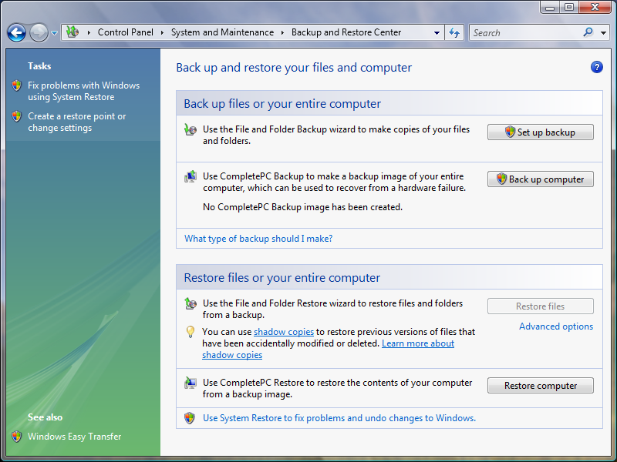

Slide 9
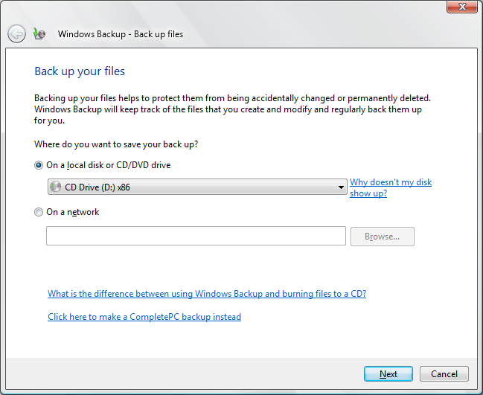
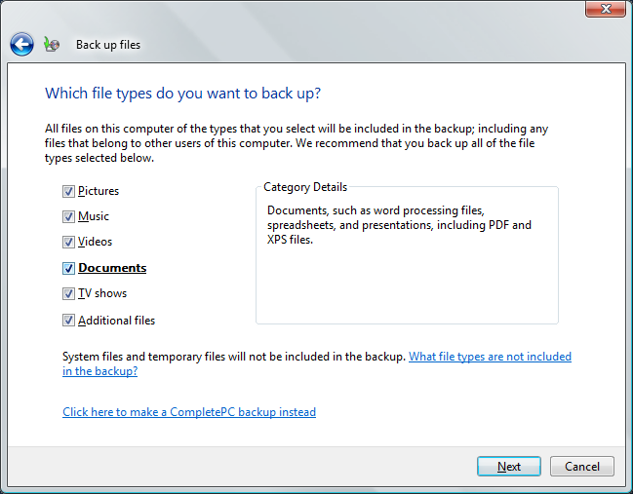
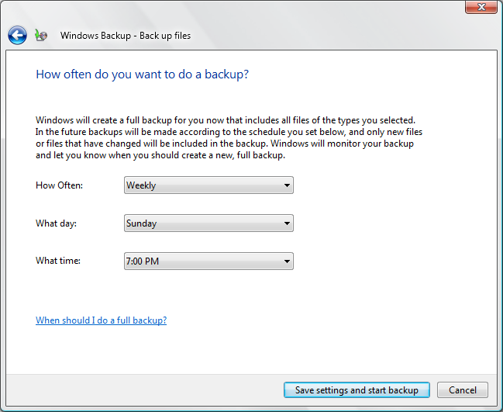

Slide 10
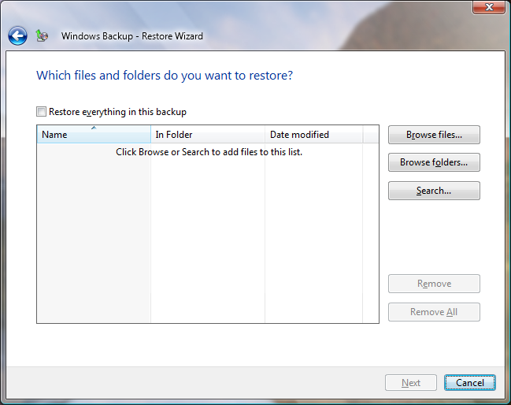
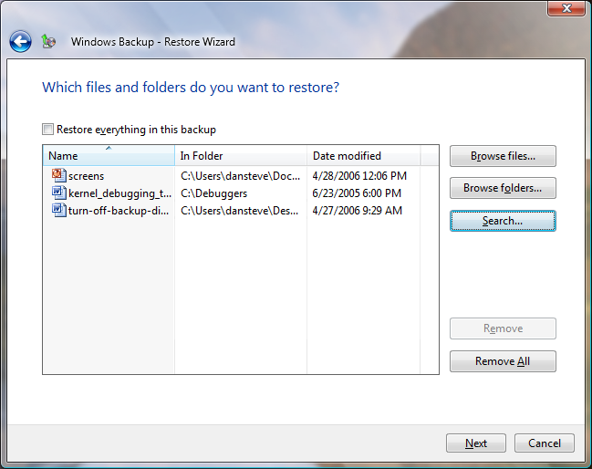
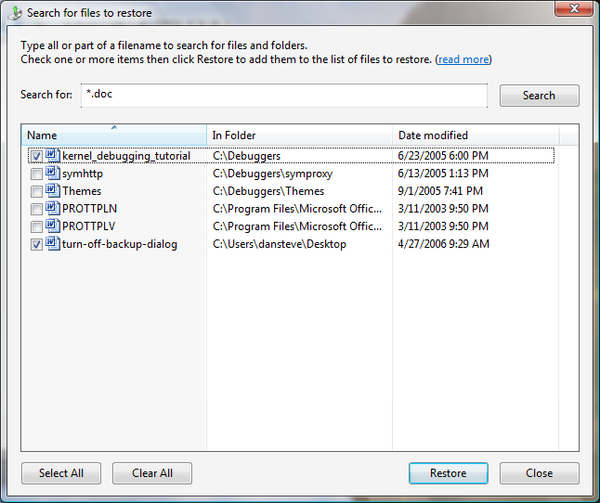
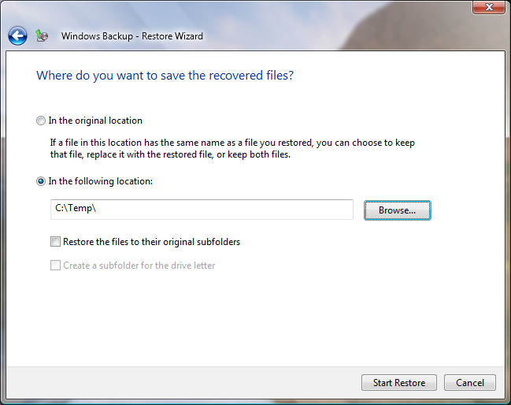
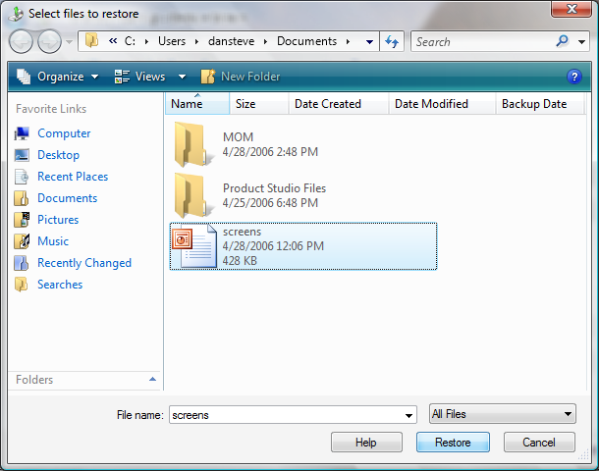

Slide 11
CompletePC Image Backup
Block-level backup of the entire PC
Great disaster recovery solution for
consumers and small businesses
Back up to an external hard disk,
internal disk partition, or a set of DVDs
Easy restore via Windows Recovery Environment (Windows RE)

Slide 12
CompletePC Backup Details
Block-level backup is very fast and efficient
Clever way to do incremental backups: each backup is “full” but deltas are small
Backup file is VHD format (Virtual PC)
CompletePC Backup is present only in Business, Enterprise, and Ultimate SKUs
Only an administrator can run backup

Slide 13
CompletePC Restore Details
Can restore all disks, or just system disks
Adapts to disk configuration changes
No more floppy disk requirement
Windows RE is not SKU-differentiated
Only physical access is required to restore

Slide 14

Incremental Image Backups
Application writes to disk
Source disk
block-level backup
update backup image
Backup disk
(image stored
in VHD file)
Shadow copy storage
to track changes
block-level restore
Older restored disk,
based on shadow copy
Restored disk,
same as source
Restored disk same as updated source disk

Slide 15
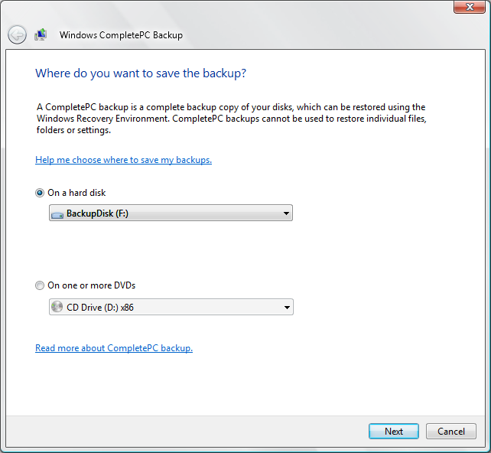
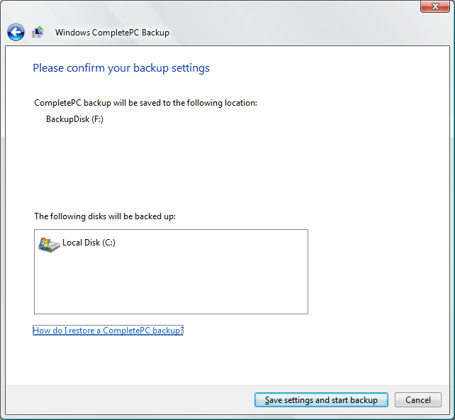

Slide 16
Windows RE Details
Based on Windows PE
Automatic recovery using Startup Repair
  Auto-repairs >80% of boot failure causes
  Leverages system instrumentation to
  diagnose driver errors and boot status
Manual recovery tools, including CompletePC restore

Slide 17
Windows RE Auto-Repair
Boot manager
detects failure
Fail over into
Windows RE
Computer
Bluescreens
Reboot
Auto-launch
Startup
Repair
No
Successful boot?
>5
attempts?
Windows Vista
starts
Yes
Yes
Cannot
auto-repair
(try manual)
No
Reboot
Diagnose
and repair
computer

Slide 18
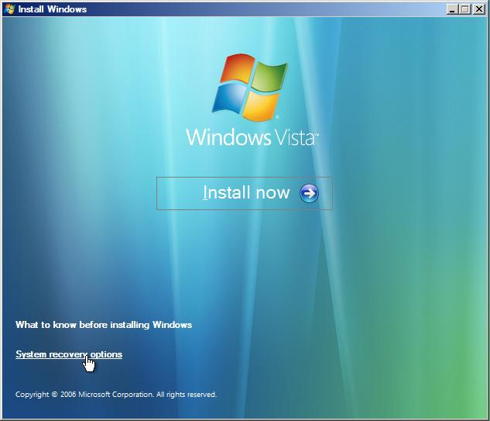
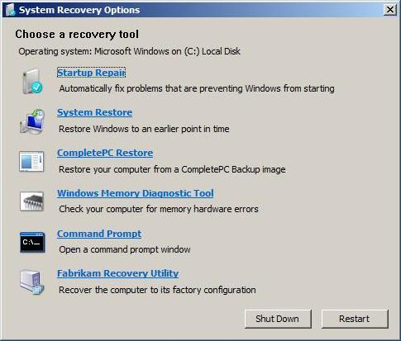
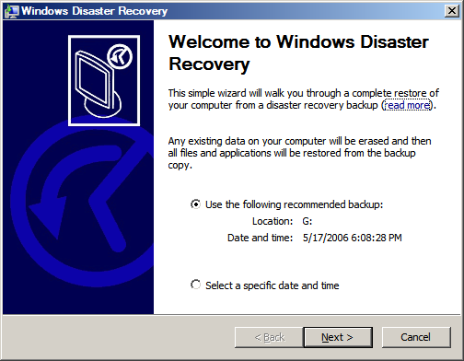
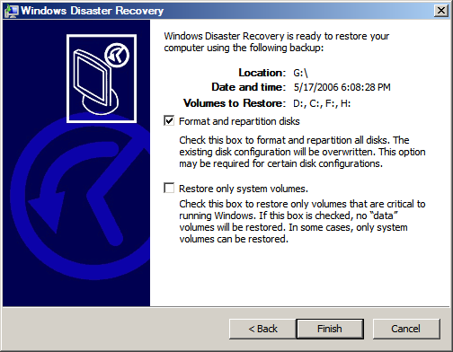

Slide 19
Windows Server Backup
Targeted at small business/DIY admin
Same block-level engine as Windows Vista’s CompletePC Backup
  Efficient incremental backups
  DVD, hard disk, or file server, but not tape
Restore entire computer, system state, individual files, and application databases
Familiar MMC look-and-feel, plus a
full-featured command-line tool

Slide 20
Server Backup Details
Many scheduling options
“No management” media rotation
Restore directly from backup image
  Files, folders, and whole disks
  SQL Server, Exchange, SharePoint data
Restore computer from Windows RE
  Bare metal or system state-only
Must be an administrator to use

Slide 21
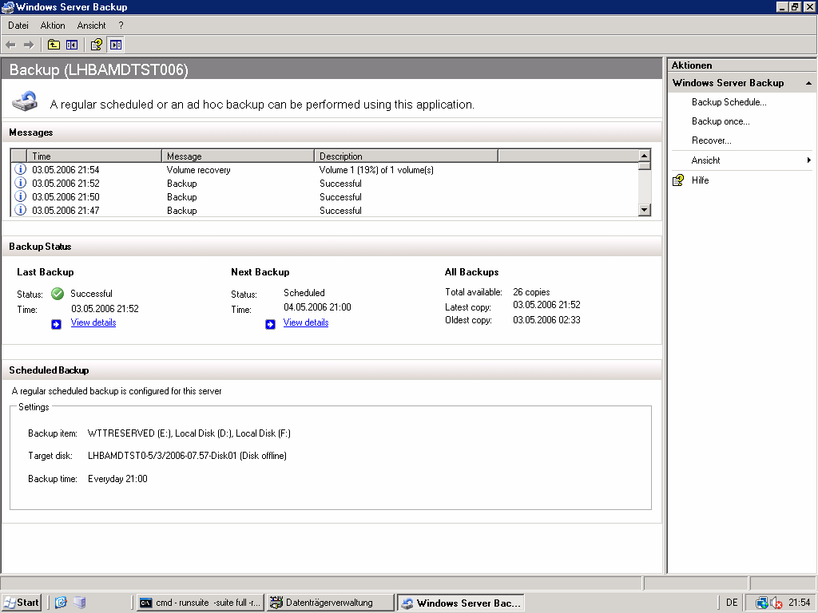

Slide 22
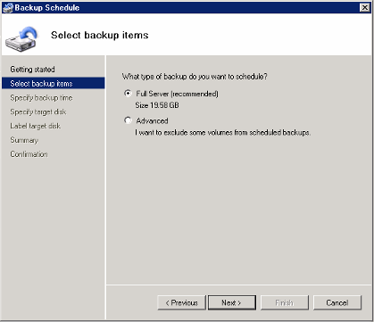
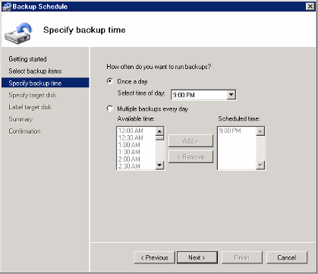
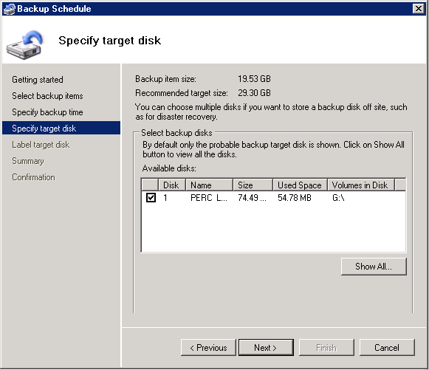
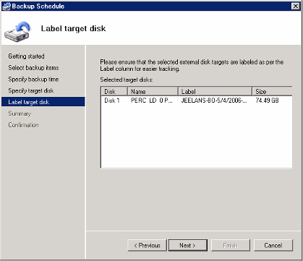
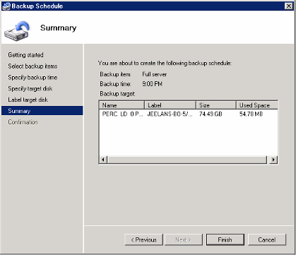
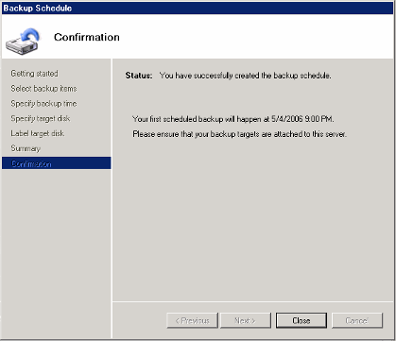

Slide 23
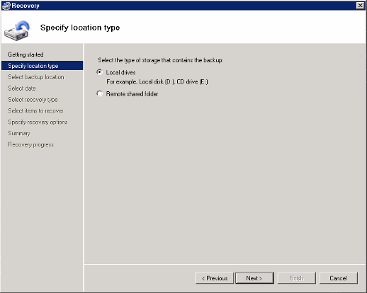
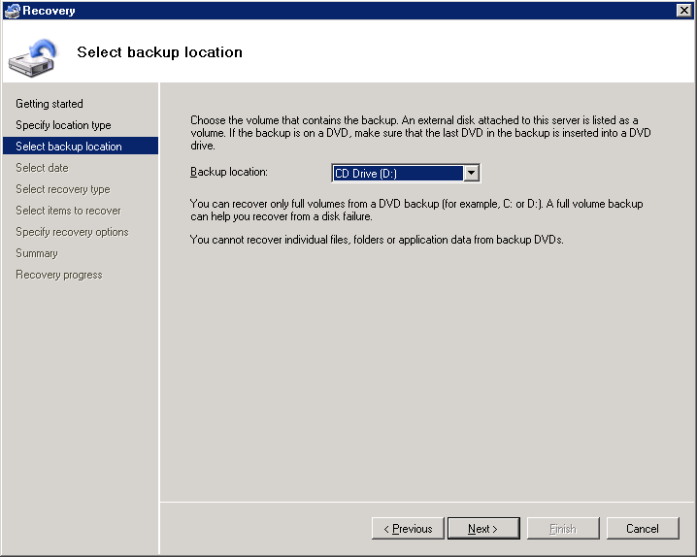
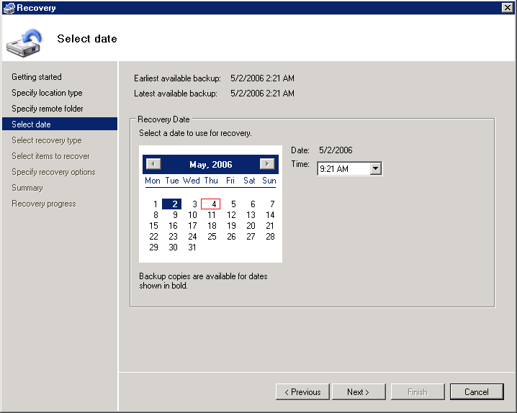
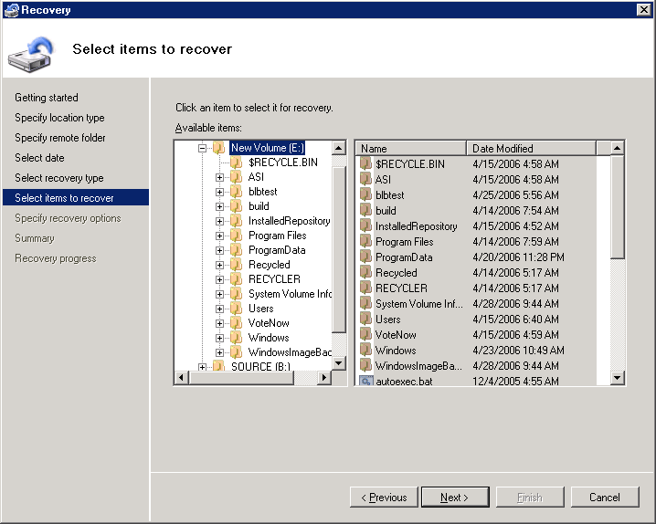

Slide 24

Windows CompletePC
Image Backup And Restore

Slide 25
Hardware Opportunities
Focus on new backup media
Windows Vista and Windows Server “Longhorn” support new backup media
  CD, DVD, and larger via UDFS
  Hard disks, especially for block-level backup
With these features, more customers will use hard disks and CDs/DVDs for backup

Slide 26
Hardware Opportunities
In Windows Vista, NTFS pays attention
to the “hot pluggable” device policy
  Default is “optimize for removal” (slow)
  User or tool can set “optimize for performance”
Devices must have Windows Vista logo
Other considerations
  Please don’t under/over-report capabilities
  Allow cancellation of writing and formatting
  Do not incorrectly report disk as “removable”

Slide 27
Hardware Opportunities
Recommended configurations
 | File Backup | CompletePC Backup and Server Backup
USB hard disk | Best with NTFS, optimized for performance | Incremental requires NTFS, optimized for performance
CD/DVD | All writable media should work | All writable DVD media should work
Removable hard disk (cartridge) | Best results with NTFS, will span if gets too big | Only spanning (no incrementals)
USB flash disk | Not directly supported (will work if “reader”) | Not directly supported

Slide 28
Integration Points
File backup
  Runs as a scheduled task, which can be modified or disabled
CompletePC and Windows Server Backup
  Scriptable command-line tool “wbadmin.exe” exposes all backup and restore functionality
  Server backup runs as a scheduled task
  Windows RE can be customized

Slide 29

Interesting Future Problems

Slide 30
Interesting Future Problems
New and different backup media
  Large-capacity USB flash devices, cartridge-style hard drives, network “cloud” storage
  Challenge of shared access
Backup media longevity is very important
Windows RE is not always available
Customers use large-capacity portable storage media for more than backup

Slide 31
Call To Action
Develop backup devices and media
Give Microsoft feedback on features, requirements, and hardware directions
Ensure devices and media work with the new backup features, and certify via the Windows Vista Hardware Logo Program
Start planning for Windows Vista launch
Take Windows Vista 101 online course, learn about partner opportunities

Slide 32
Additional Resources
Partner Marketing Day – 6/14 in
San Francisco: dmoulton @ microsoft.com
Windows Vista 101: www.windowsvista.com/partner
Hardware logo program and resources: www.microsoft.com/whdc
Feedback and questions:
recovery @ microsoft.com

Slide 33




Backup Is Important
(Obligatory hockey stick chart)
home
data
disk
size
1940 GB
478 GB
15,000,000
322 GB
home
file servers
86 GB
340,000
2004
2005
2006
2007
2008
2009
2010
Home data and file servers from Coughlin, 8/05
Disk size from Gartner, 4/05

Slide 34

© 2006 Microsoft Corporation. All rights reserved. Microsoft, Windows, Windows Vista and other product names are or may be registered trademarks and/or trademarks in the U.S. and/or other countries.
The information herein is for informational purposes only and represents the current view of Microsoft Corporation as of the date of this presentation. Because Microsoft must respond to changing market conditions, it should not be interpreted to be a commitment on the part of Microsoft, and Microsoft cannot guarantee the accuracy of any information provided after the date of this presentation.
MICROSOFT MAKES NO WARRANTIES, EXPRESS, IMPLIED OR STATUTORY, AS TO THE INFORMATION IN THIS PRESENTATION.

Slide 35
